Slide 1
How To Get Good Grades
In Ten Easy Steps

Slide 2
Notes:
If this is your defn of study – you are in troooouuubbbllle!

Slide 3
What Kind of Student Are You?
Quiz – Put check marks in the spaces that best describe you.
Give yourself 2 points for each Almost Always, 1 point for each Sometimes, and 0 for each Hardly Ever response.
What Your Score Means
20-16 points: You are a good student. This presentation will most likely be a review for you. It could, however, help you raise your grades even higher.
15-11 points: You are a student who could be getting better grades. With this presentation, you will definitely be able to improve your grades.
10-6 points: Your grades probably aren’t very good. This presentation can help you change that. It could even help you change how you feel about school.
5-0 points: Your grades need serious improvement. Don’t give up. This presentation can help you turn your grades around.
Notes:
Hand out sheets

Slide 4
Step One Believe in yourself
“To Succeed, we must first believe that we can”
– Michael Korda, Author

Slide 5
Take a minute and on the sheet provided, create a chart like the one below. List the courses you are currently taking.
Then in the “Grade” column, write down the highest grade you think you can earn in each course.
Think of these grades as your goals.
Course | Grade
Math | 75%
Notes:
On the back of the sheets previously used

Slide 6
Step TWO Be organized
If you’re organized, you have what you need when you need it. This section will give you a number of ideas on how to be organized. Of course, you must determine what’s going to work best for you.

Slide 7
Use a Student planner
Take a student planner with you to every class and record each assignment under the date it’s given. Also write down the date each assignment is due. Use your planner to also keep track of test dates and activities.
A few examples of apps:
Studious
Myhomework app
iStudiez Pro
Todomatrix
“When I look at my student planner at the end of the day, it reminds me of which books I need to take home” Maria
Notes:
Can get planners and agendas on ipads, phones. Show sample apps.

Slide 8
Break Down Assignments
Large assignments are much easier to do if you break them down into smaller parts. For example, if you have an English paper that’s due at the end of the week, you could give yourself these four assignments:
Mon – Do research Wed – Write rough draft
Tues – Do outline Thurs – Finish paper
Writing these kinds of smaller assignments in your planner will help you do your big assignments over a period of time, not at the last minute.
Notes:
Use example students are working on now (e.g. speech)

Slide 9
Use Three-ring Binders For Class Notes
Binders work well because handouts can easily be inserted, and if you do miss a class, you can copy someone else’s notes and insert them where they belong. If you purchase a 3-hole punch and keep it in your notebook, you can hole punch your handouts in class and put them in your notebook as soon as you get them.

Slide 10
Use Folders For Schoolwork
Have a different coloured pocket folder for each class. When a folder starts to get full, take the returned papers out and put them in a safe place at home.

Slide 11
Have Phone Numbers For Classmates & Use Your Student Portal
Make sure that you have a phone number for at least one person in each class. If you’re absent or have a question about an assignment, you’ll then have someone to call (or text).
Touch base with your teacher!!!
Do you know how to use your student portal? https://pschool.nlesd.ca/public/home.html

Slide 12
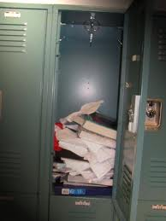
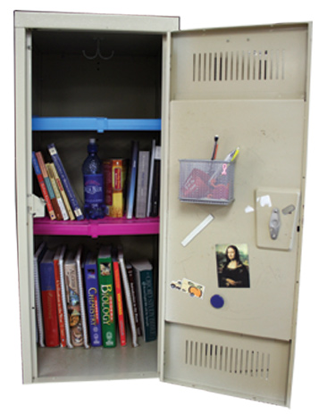
Keep Your Locker And Backpack Neat
Never stick loose or folded papers insides books, your backpack, or your locker. Always put them in the correct folder or notebook. Keeping your locker and backpack neat, clean, and organized makes it much easier to locate materials.

Slide 13
Get Organized Before You Go To Bed
Each night, put completed homework in the right folders and get everything organized for the next day. If there’s something you need to remember to do in the morning, leave yourself a note so that you don’t forget it.
Notes:
Also, positive messages ☺

Slide 14
Step Two
Be Organized
Use a student planner
Break down assignments
Use three-ring binders for class notes
Use folders for schoolwork
Have phone numbers for classmates
Use your student portal
Keep your locker and backpack neat
Get organized before you go to bed

Slide 15
Step 3 Manage your time well
With good time management, you have time for the things you need to do, and still have time for the things you want to do.
Use FREE class time and study time to start on homework, ask questions, or get help.

Slide 16
Create Your Own Student Plan
Some students study best at night. Others study better earlier in the day. Many students also have sports activities, or other responsibilities they need to work around.
At the end of each day, figure out how much time you have available, look at how much homework you have, and then develop a study plan. To keep yourself organized and “on track”, have a study plan in mind before you get home from school each day.
Notes:
Example on the board

Slide 17
Prepare For
Identify anything that could interrupt or ruin your study plan. Then figure out how to eliminate or avoid it.
“I can’t stand watching TV until I have all of my homework done. If I turn on the TV, my homework probably won’t get done” - Joan
“I used to get interrupted by phone calls. Now I tell my friends not to call until 9:00 – I just make sure that my homework’s done by then” - Kate

Slide 18
Step Three
Manage Your Time Well
Use class time and study time
Create your own study plan
Prepare for disruptions

Slide 19
Step Four Be Successful in Class
If you follow the advice in this section, you’ll enjoy school more and you’ll get better grades

Slide 20
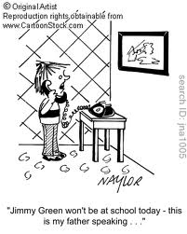
Be In School, On Time, Every Day
When you miss school, you miss class presentations, notes, discussions, assignments, quizzes, and tests. It doesn’t matter how good you are about making up your work, you can never make up all of what you miss, even if you’re out of school for only one day. To get good grades, you must be in school every day.
Unless you have an extended illness or a serious health problem, you should miss no more than a few days of school a year.

Slide 21
Learn How To Adapt To Different Teachers
In the classroom, the teachers are in charge and they make the rules. You might have one teacher who counts you late if you’re not in your seat when the bell rings, and another teacher who considers you on time if you have one foot inside the door. It doesn’t matter whether or not you agree with the first teacher’s rule; it only matters that you are in your seat when the bell rings.
Part of your education is to learn how to adapt to different sets of rules, personalities, and teaching styles.
“It’s really important to know your teachers and to know what they want. Do they give points for participation? Are they strict about rules? Do they grade homework?” - Brad
Notes:
Use technology as an example – some teachers allow students to use phones in class, others do not. (also, eat in class, listen to music, etc) – neither teacher is wrong, just different.

Slide 22
Be Prepared For Each Class
Have everything you need with you when you go to class (books, paper, pencils). Also have all your homework done. When you’ve done your homework, you get more out of class, the material being taught makes more sense, and you can participate in discussions. If you haven’t done your homework, you may not even understand what your teacher is talking about.
Being prepared also means that you come to class well rested and ready to learn.

Slide 23
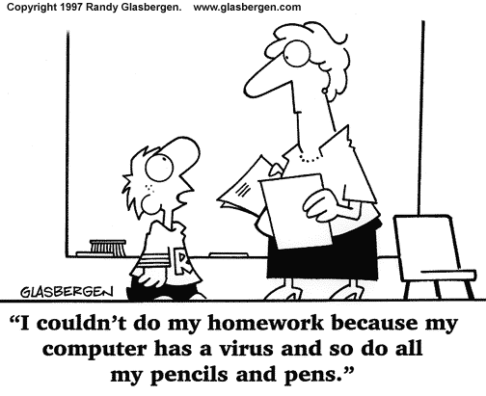

Slide 24
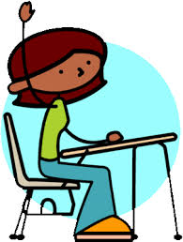
Seating Plan?
It is easier to pay attention and stay involved when you sit away from distractions. If you have a problem paying attention, ask your teacher if you can sit close to the front.

Slide 25
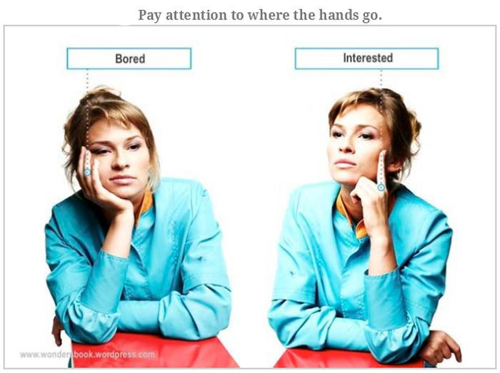
Be Aware of Your Body Language
Teachers see everything. They know who is paying attention, who’s taking notes, and who is listening to the class discussion. They also know who is doing homework for another class, writing personal notes, daydreaming and napping.
Teachers notice.
Notes:
Give specific examples. Use students

Slide 26
Always Do Your Homework
Don’t look at homework as something you should do. Think of it as something you MUST do. Since a large portion of your grade is usually based on homework, your grade drops every time you miss an assignment. Always complete your homework on time.

Slide 27
Be A Good Group Member
Whenever you are involved in a group project, do the following:
Do your share of the work and do it well
Try to be open to new ideas
Support the other members in your group

Slide 28
Participate In Class
Participating in class makes the class more interesting. It also helps keep your mind focused. Ask and answer questions, and get involved in class discussions. Many teachers give participation points so participating can also help you get a better grade.
Treat Others With Respect
Treat your teachers and classmates the same way that you want to be treated.

Slide 30
Involve Your Parents
When your parents ask when your did in school, tell them something about your day.
Ask for help if you need it
If you have a problem in school, ask your parents to help you resolve it
Remind your parents about the parent portal
Take responsibility For Your Grades
Be proud of your accomplishments.
Don’t make excuses for poor grades. Figure out why your grade is low, and DO SOMETHING ABOUT IT.
Always do your own work.
Notes:
Parent Portal – menihek

Slide 31
Step Four
Be Successful in Class
Be in school, on time, every day
Learn how to adapt to different teachers
Be prepared for each class
Sit in front of the class, if possible
Be aware of your body language
Always do your homework
Be a good group member
Participate in class
Treat others with respect
Involve your parents
Take responsibility for your grades

Slide 32
Step Five Take Good Notes
Tests usually cover material that’s been presented in class. It is, therefore, important to have good notes from which to study.

Slide 33
Be an Active Listener
What’s the difference between being a passive listener and an active listener?
When you are actively listening in class, you aren’t just hearing the words the teacher is saying, you’re also thinking about and trying to understand the information that’s being presented.
Take Notes to Help You Pay Attention
You can think much faster than anyone can talk. This is one of the reasons that your mind sometimes wanders when you’re listening in class. When you take notes, however, your mind has something additional to do, and you don’t have time to think about anything else. Taking notes, therefore, helps you stay focused.
Notes:
Story about song on the radio – listening to a song while doing other stuff (drying your hair, eating breakfast), and stopping, sitting down and listening to each word of the song.

Slide 34
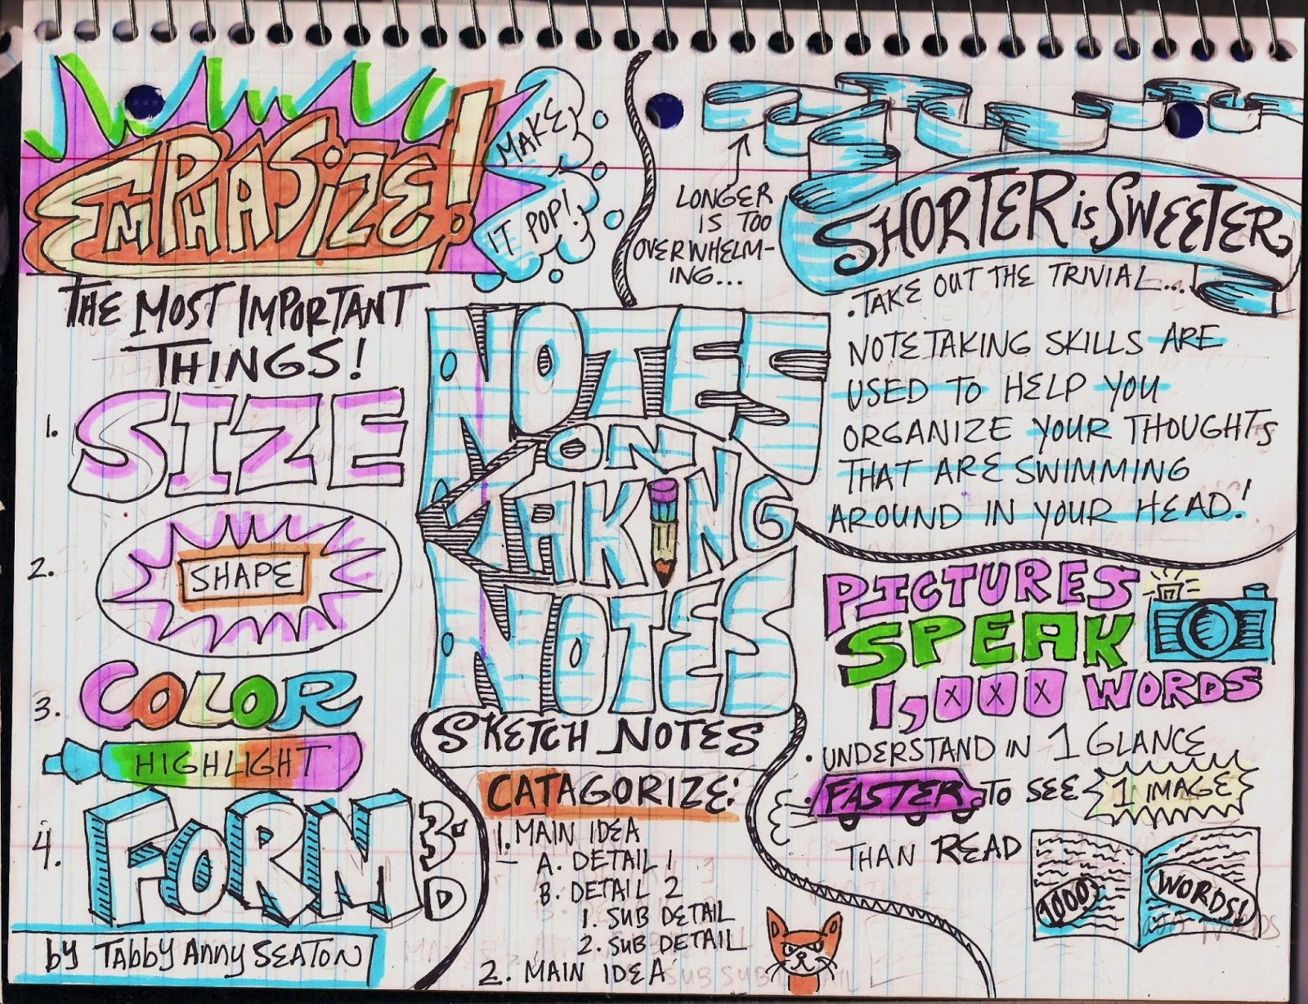
Recognize Important Information
Hear a change in your teacher’s voice
Anything your teacher writes on the board
Highlight, star, underline, etc.
.
Notes:
Give examples of voice changes

Slide 35
Take Notes That Are Easy to Read
Put the name of the class, the date, and the page number at the top of each page of notes.
Put the subject of your notes at the top of the page
Skip lines between topics and only use one side of the paper
Use symbols and abbreviations whenever possible. For example:
= equal → resulting in
w with w/in within
b/c because esp especially
< less than * most importantly
Leave a wide margin for key words
Notes:
Google ideas and shortcuts. Show example on the board.

Slide 36
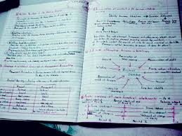
Go Over Your Notes as Soon as Possible
While the information is still fresh in your mind, take five minutes to go over your notes. Redo anything that’s confusing, fill in the spaces, and make sure that you have all your key words written in the left-hand margins.
Notes:
Homework – don’t ever say you don’t have any!

Slide 37
Get Copies of Class Notes if You’re Absent
If you miss a class, it is YOUR responsibility to ask your teacher about assignments, hand-outs, etc. It is also your responsibility to make up any work that you’ve missed.

Slide 38
Step Five
Take Good Notes
Be an active listener
Take notes to help you pay attention
Recognize important information
Take notes that are easy to read
Go over your notes as soon as possible
Get copies of class notes if you are absent

Slide 39
Step Six Know How to Read a Textbook
Textbook authors have already done the work for you.
How??
Notes:
Boldface, Italics, pictures, charts, graphs, lists

Slide 40
Scan, Read, Review
Scan: gives you a quick overview of the material
read the title, subtitles, and everything bold and in italics
Read: for purpose, when you do your comprehension improves and it’s easier to stay focused. For example, turn all boldfaced subtitles into questions. As you read through the section try to answer your question.
Review: Taking a few minutes for review will make a huge difference in what you are able to remember later.

Slide 41
Step Six
Know How to Read a Book
Scan by reading subtitles, words in bold and italic print, summaries, charts, and review questions.
Read with a purpose
Review by scanning the material to check your comprehension
Notes:
END OF CLASS

Slide 42
Step Seven Study Smart
Students who “study smart” find that they spend less time studying, and yet they get better grades.
Really??
Notes:
Boldface, Italics, pictures, charts, graphs, lists
Give example of two students: one student studies for 3 hours and one student studies for 5 – who does better? The 3 hour “Study Smart” student does better because he/she knows HOW to study

Slide 43
Find a Good Place to Study
It doesn’t matter where you study, as long as you have a good surface to write on, it’s well lit, and it’s comfortable.
Some people like to study with music, and some people do not. If you do, keep it soft (research has shown that classical music can actually improve your concentration).

Slide 44
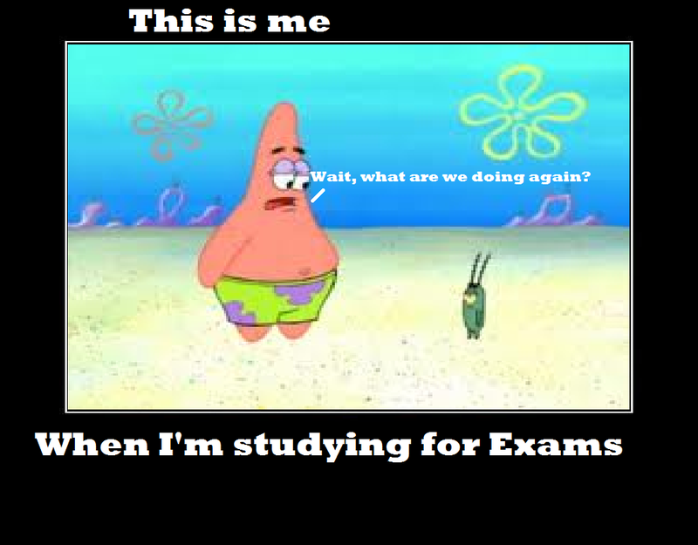
Get Started
This is the hardest part of studying.
Don’t put it off until later, don’t make excuses, and don’t wait until you’re “in the mood”. If you have a hard time getting started, begin with something simple, or a subject you like.

Slide 45
Know Your Learning Style
We all learn differently.
“Students learn 10% of what they read, 20% of what they hear, 30% of what they see, 50% of what they see and hear, 70% of what is discussed with others, 80% of what they experience personally, and 95% of what they teach to someone else.”

Slide 46
Organize Your Study Time
Make a plan.
Prioritize your work.
If it gets overwhelming, break it down.
Always allow more time than you think you’ll need
If you have something to memorize, do that first, then go over it again at the end of your study session.
Do difficult assignments first, while you’re still alert and fresh.
Alternate types of work (read English, do Math, read History)
Take break

Slide 47
Know How to Study for Tests
Know what the test will cover
5 W’s + H
Pay really close attention the day before a test.
Have all the reading done ahead of time
Complete textbook review questions. Pay attention to bold and italicized words in your texts
Study review sheets. Use the review sheet to make up questions to ask yourself.
Explain things in your own words (teach it to yourself)
Review often and review out loud. Review is the key to learning anything – it moves information from your short term memory to your long term memory.
Write down any names, dates, formulas, and/or facts on index cards.

Slide 48
Use Tricks to Help You Memorize Information
Use flashcards.
Write down what you want to memorize and stare at it.
Go over information that you want to memorize right before you go to sleep.
Use acronyms (e.g. HOMES).
Use the first letter of a word to create a silly rhyme (e.g. My very elegant mother juggled seven ugly neckties).
Look for connections.
Group or categorize (lists, diagrams)
Use crazy pictures or images
Notes:
HOMES – great lakes (Heron, Ontario, Michigan, Erie, Superior
My very elegant mother juggled seven ugly neckties – Mecury, Venice, Earth, Mars, Jupiter, Saturn, Urnanus, Neptune

Slide 49
Know How to Write a Paper
Spread it out over as much time as possible.
Follow an outline. For example:
Choose a topic
Gather information
Make an outline
Write a rough draft
Read your paper out loud
Think of ways to improve your paper, and then rewrite it
Have someone else read it
Write the final draft
Check for spelling and grammatical errors
Make sure that your paper looks neat and clean and hand it in on time

Slide 50
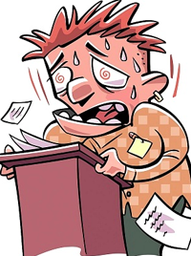
Use Tricks When Making a Presentation or Speech
Use props whenever possible
Pretend that you are telling your best friend something really important
Make eye contact (or at least look at foreheads)

Slide 51
Have Good Computer Skills

Slide 52
Step Seven
Study Smart
Find a good place to study
Get started
Know your learning style
Organize your study time
Know how to study for tests
Use tricks to help your memorize information
Know how to write a paper
Use tricks when making a presentation or speech
Have good computer skills

Slide 53
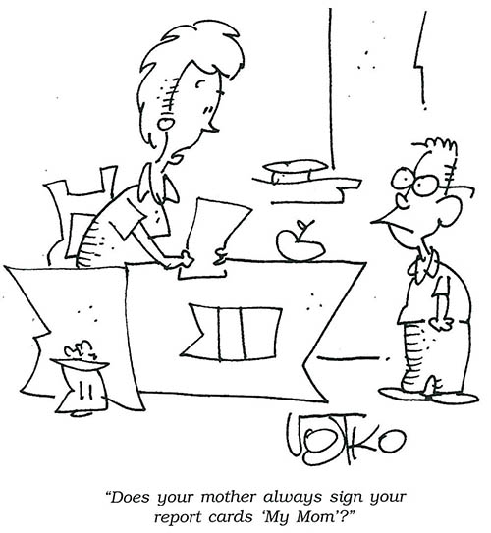
Step Eight Use Test Taking Strategies
Notes:
Boldface, Italics, pictures, charts, graphs, lists

Slide 54
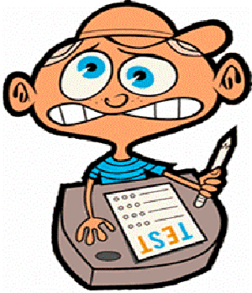
Get Off to a Good Start
Have everything you need.
As soon as you get your test, write down anything that you want to remember (facts, dates, formulas, etc)
Read the directions CAREFULLY
Notes:
It’s not cheating

Slide 55
Develop a Plan
Before you begin answering questions, quickly look over the entire test and develop a plan. For example, if a one hour test has 25 MC, and 2 essay questions, you could plan to spend 10 minutes on the MC questions, 20 minutes on each essay question, and 10 minutes checking it over.
Notes:
Time according to how much it’s worth

Slide 56
Mark The Questions You Want to Return To
As you go through the test, put a mark or dot by a question you are unsure of. After you’ve gone through all the questions, go back to the ones that you’ve marked, and try them again.
Don’t spend a lot of time on difficult questions, and don’t panic if you don’t know the answers to the first few questions. Sometimes it takes a few minutes for your brain to get in gear.

Slide 57
Increase Your Odds on Multiple Choice Questions
As you read through a MC question, try to come up with an answer before you look at your choices
If you are unsure of an answer, eliminate the choices you know are incorrect by crossing them out. Then make an educated guess.
If two of the choices are similar or opposite, one of them is probably the correct answer.
Read all of the answer choices. At least a couple of the answers will probably sound like they could be correct. Don’t be tempted to mark the first answer that sounds good.

Slide 58
Choose the correct form of the verb in brackets: He's very happy in Canada. He _______________(live) in Canada since 1994.
He have lived in Canada since 1994.
b. He has lived in Canada since 1994.
c. He lives in Canada since 1994.
d. He live in Canada since 1994.

Slide 59
Look For Key Words in True/False Questions
Statements with always, never, every, all, and none in them are usually false.
Statements with usually, often, sometimes, most, and many in them are usually true.
Read true/false questions very carefully. One word will often determine whether a statement is true or false.

Slide 60
1. All turtles can breath through their butts.
True or False?
False:
Hehe. Yes, some do, but not all. Check out the Fitzroy river turtle, which is native to Australia.
2. In Portugal, McDonalds serves up to 10 varieties of soup.
True or False?
TRUE.
McDonald’s restaurants around the world are known for their regional differences. Some of these variations include serving Banana pie in Brazil, shawarmas in Egypt, Spinach and Parmesan McNuggets in Italy, and beer in many European countries such as France, the Netherlands, Germany and Portugal.

Slide 61
Know How to Approach Essay Questions
Read each question and then start with the easiest one. Note how many points each essay is worth, and adjust the time you spend on each question accordingly.
Before you do any writing, brainstorm. Jot down the key words, ideas, and points you want to cover in your answer. If you have time, organize your ideas into a quick outline.
Begin writing. Use clear, concise, complete sentences, and write neatly. Remember the rules for writing an essay that you learned in English class.
If you don’t know the answer to an essay question, take a couple of minutes to write down something you do know about the subject. Partial credit it better than nothing.
Notes:
Confidence
Studies have shown that when two identical essays are grades, the one that’s easier to read gets the higher grade.

Slide 62
Improve Your Math Test Scores
Before you start to solve a problem, try to estimate what the answer will be.
If you are having difficulty with a problem, try drawing a picture or diagram.
Don’t spend too much time on one problem. If you get stumped, go on, and come back later to it.
Show all your work!

Slide 63
Be Prepared For Open Book Tests
Use the following tips to help you locate information quickly during an open book test.
Highlight your notes.
Use stickies or bookmarks to help you locate information quickly.
Write down all the information that you know you’ll need on a separate sheet of paper.

Slide 64
Check Your Answers
If you have time, check all of your answers, even the ones you know are correct.
Always use all of the time you are given.

Slide 65
Go Over All Returned Tests
Go over each question you missed and write in the correct answer.
Use your tests to study for cumulative exams, midterms, and finals.

Slide 66
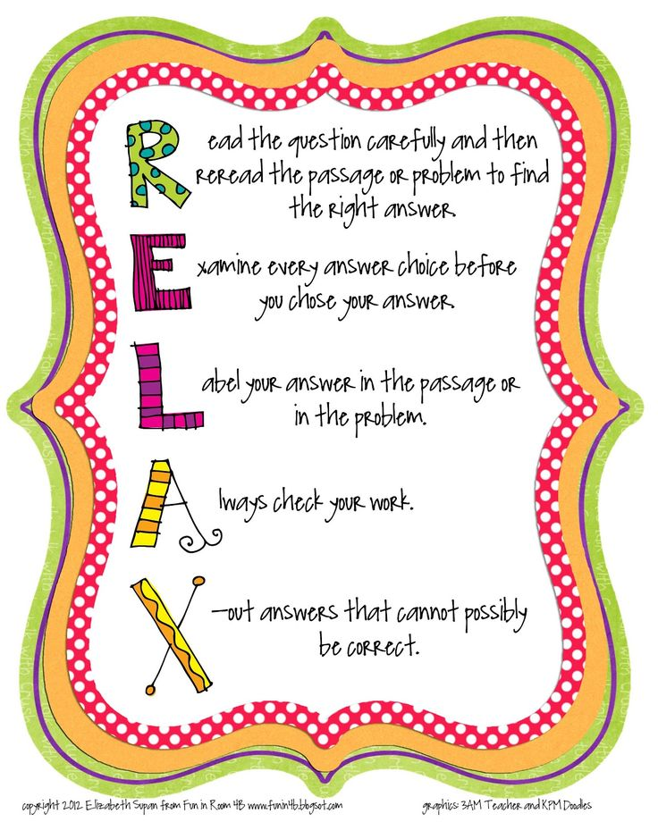

Slide 67
Step Eight
Use Test Taking Strategies
Get off to a good start.
Develop a plan.
Mark the questions you want to return to.
Increase your odds on MC questions.
Look for key words in T/F questions.
Know how to approach essay questions.
Improve your math test scores.
Be prepared for open book tests.
Check your answers.
Go over all returned tests.

Slide 68
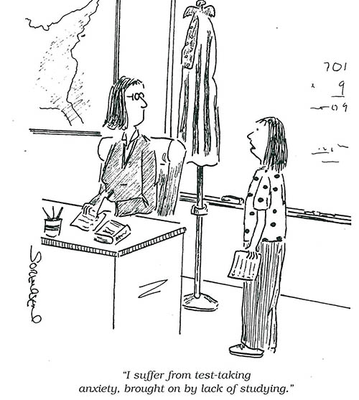
Step Nine Reduce Test Anxiety
Notes:
Boldface, Italics, pictures, charts, graphs, lists

Slide 69
To reduce test anxiety, study enough to feel confident that you know the material. Then try to replace the worry and negative thinking with thoughts that are positive and relaxing.
Notes:
Computer comparison

Slide 70
Some of the following suggestions may help you:
Start studying early. Cramming increases anxiety.
Mentally practice going through the testing experience. Close your eyes and see yourself confidently walking into the test, answering the questions correctly, and receiving the grade you want.
The night before the test, review the material and get a good night’s sleep.
Walk into the test with your head up and your shoulders back. If you act confident, you may just find that you feel more confident.

Slide 71
Try These Four Common Relaxation Techniques:
Take a deep breath. Then slowly release your breath, along with any tension. Do this until you feel your body relax.
Start at the top of your head, flexing, and them relaxing each part of your body.
Close your eyes and visualize warm sunshine washing over you, melting away the tension, and relaxing all your muscles.
Think of a place where you feel very relaxed and calm. Close your eyes and visualize being in that place.

Slide 72
Step Ten Get Help When You Need It
Notes:
Boldface, Italics, pictures, charts, graphs, lists

Slide 73
When you have a problem, do something to resolve it.
If you are having trouble in a specific subject, talk to your teacher.
If you have other personal issues, talk to an adult you trust.
Notes:
Elephant example.

